Slide 1
Flight Cost Analysis
By: Connor Crossey, Sharon Combs Darst, Sai Kondrakunta, Kelly McVey, and Julian Yanez

Slide 2
Project Description
We will be analyzing flight data from 2008 – 2018 (decade)in order to find the trends in airfare and impact on travel volume over time.
Data Sources:
AirFare & Passenger data came from Bureau https://www.transtats.bts.gov
https://data.oecd.org/energy/crude-oil-import-prices.htm#indicator-chart
S & P Global Plats / Oil Market PDF

Slide 3
Project Process
1. Decided on project theme
2. Identify data sources
3. Hypothesis
4. Analzed the information
Parsed
Stats
Graphing
5. Review, reorganize
6. Conclusions

Slide 4
Passenger Trends Annually & Quarterly
file:///C:/Users/sharo/AppData/Local/Packages/Microsoft.MicrosoftEdge_8wekyb3d8bbwe/TempState/Downloads/airefare_timeHtml.html

Slide 5
Airfare Trends over time
https://plot.ly/~saikondrakunta/2/airfare-over-time/#/

Slide 6
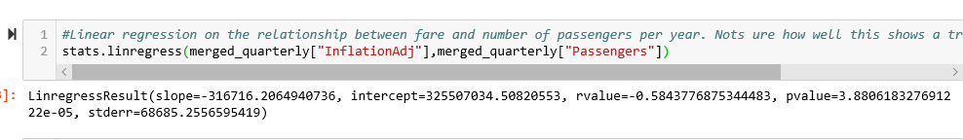
Compare effects of airfare on travel volume
https://plot.ly/~saikondrakunta/4/passengers-vs-airfare/#/

Slide 7
Oil Price over time
https://plot.ly/~saikondrakunta/6/oil-prices-over-time-by-quarter/#/

Slide 8
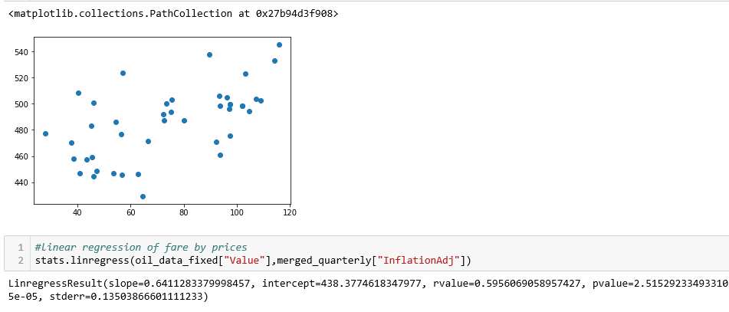
Airfare vs Oil Prices
https://plot.ly/~saikondrakunta/8/airfare-vs-oilprices/#/
https://plot.ly/~saikondrakunta/2/airfare-over-time/#/

Slide 9
Airfare & Passengers Compared
airefare_passengersHtml

Slide 10
airefare_passengersHtml

Slide 11
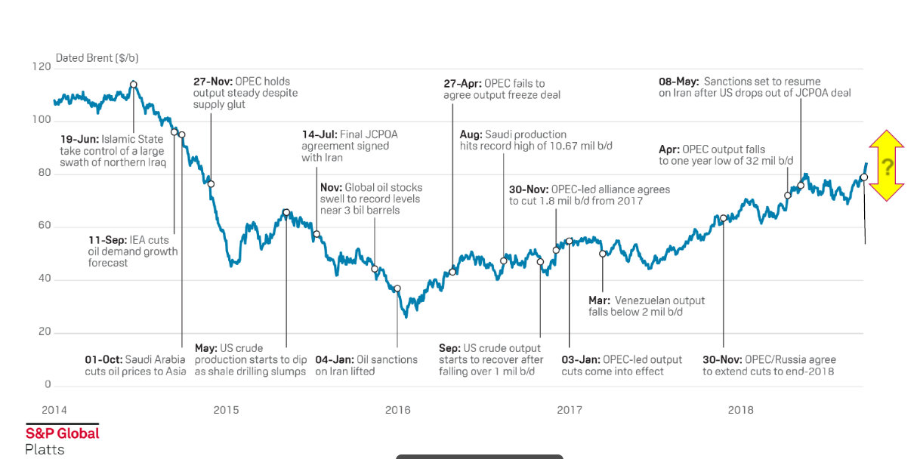
Oil Prices over time

